Slide 1
Introduction
CSCI 4150/6050: Computer Vision

Slide 2
Pixels Everywhere!

Slide 3
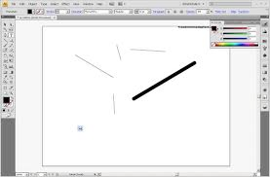
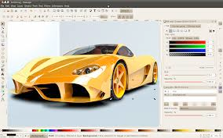
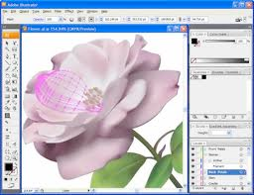

Drawing

Slide 4

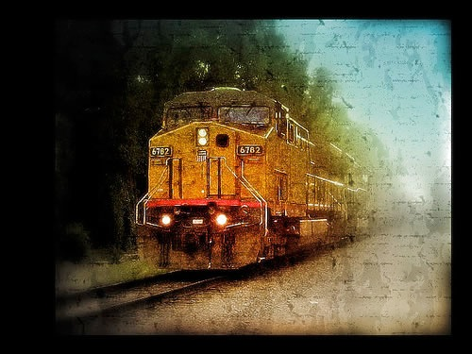

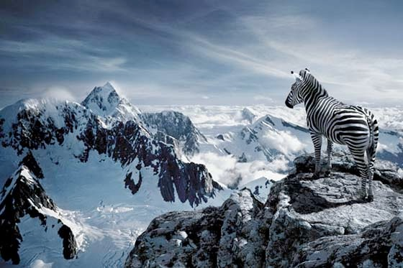
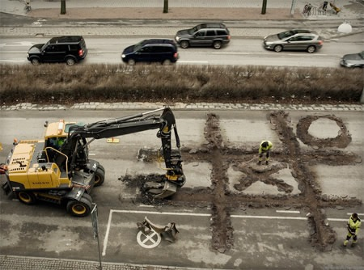
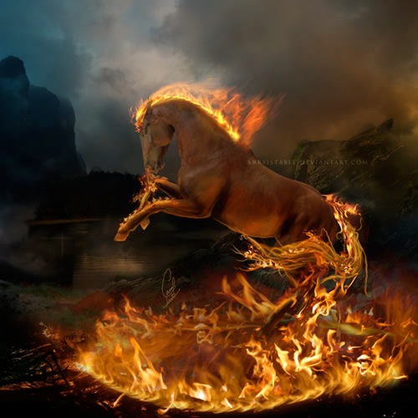
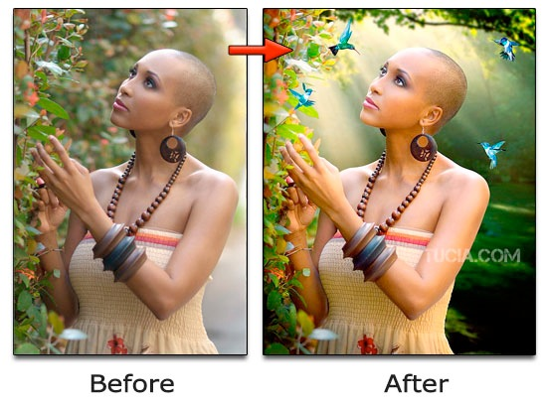


Image Editing

Slide 5
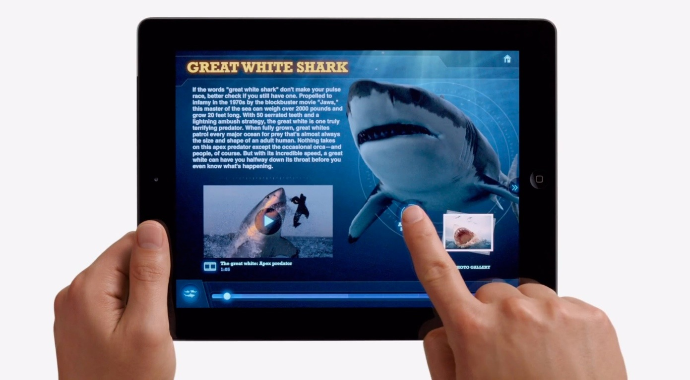
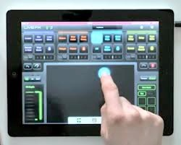
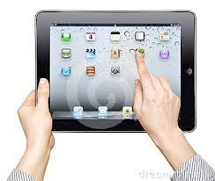
Graphical Interaction

Slide 6
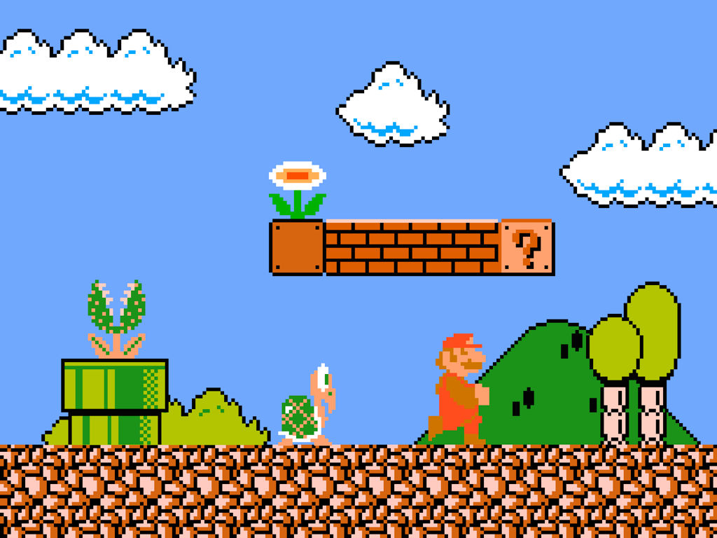
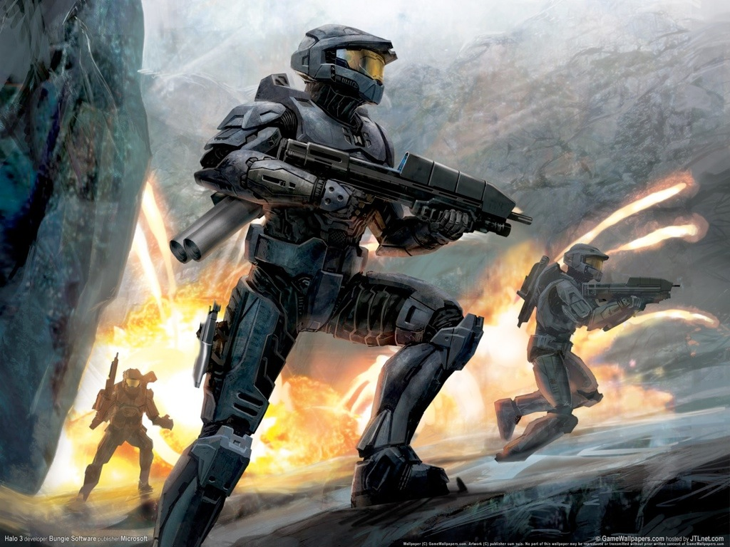
Games

Slide 7

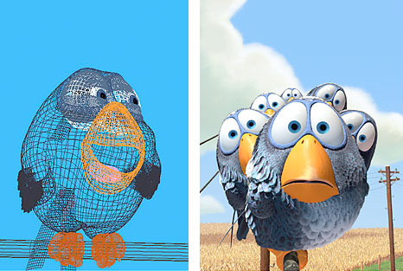
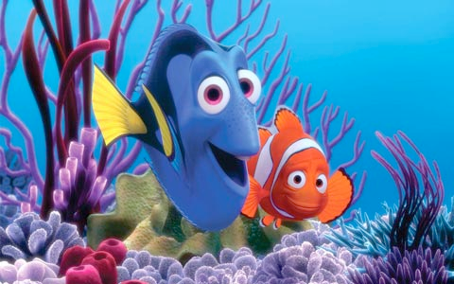

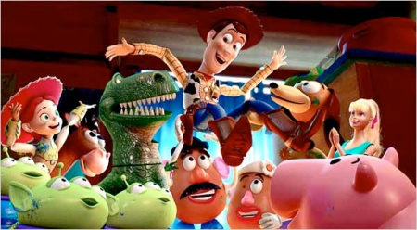
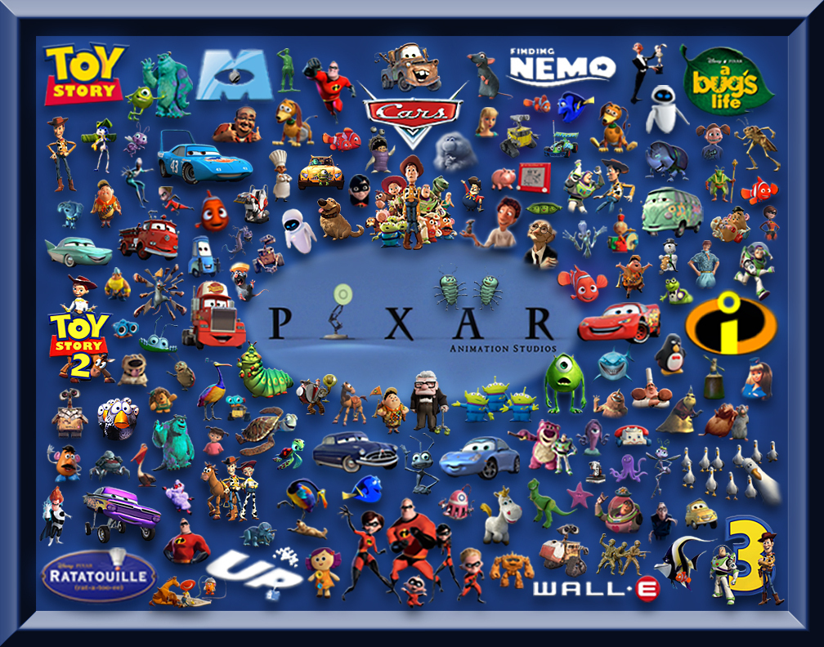
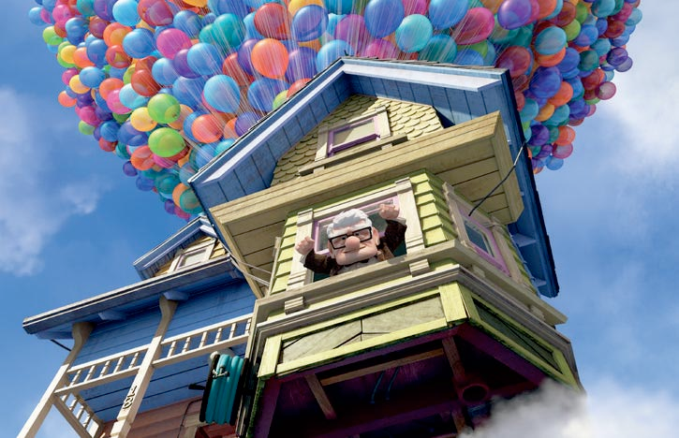
Animated Films

Slide 8

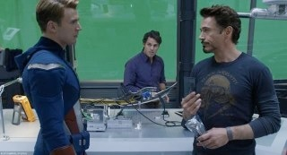
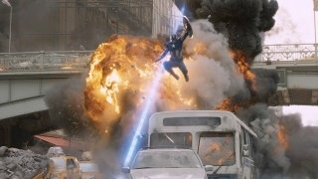
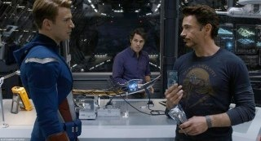
Special Effects

Slide 9
Geometry
Math
Pixels Everywhere!
Algorithms

Slide 10
Graphics, Image Processing, and Vision
Graphics
Scene
Descriptions
Image
Vision
Image Processing

Slide 11
What You’re Going to Build
Image Processing
  Brightness, contrast adjustment
  Color image processing
  Blending and compositing
  Neighborhood operations:
    noise removal
    sharpening, edge detection
  2D Transformations
    Simple rotation, translation, scale
    Homographies
Traditional and Modern Computer Vision
  Image Features
  Object Detection and Correspondence
    Tracking and Image Stitching
  Classification
    Convolution Neural Networks
  Segmentation
  Image Synthesis and Generative AI
    Exploration of State-of-the-Art
Frequency-domain processing… maybe

Slide 12
Syllabus
Prerequisites
Policies
Schedule
Programming Labs
Practice Quizzes
Exams

